Slide 1
Business Case & Findings
For Abbys Foodtruck Company
-28/12/2018

Slide 2
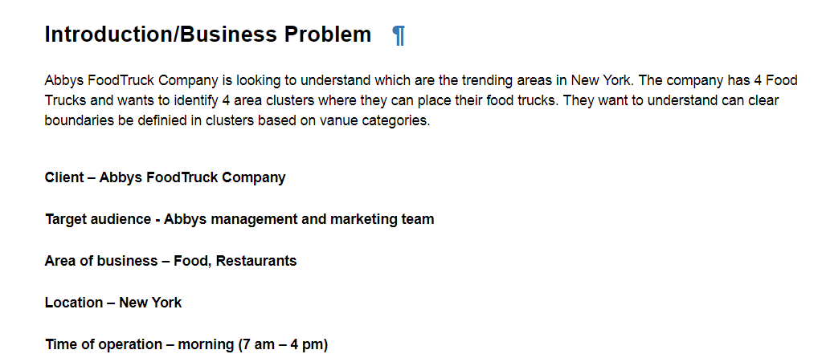

Slide 3
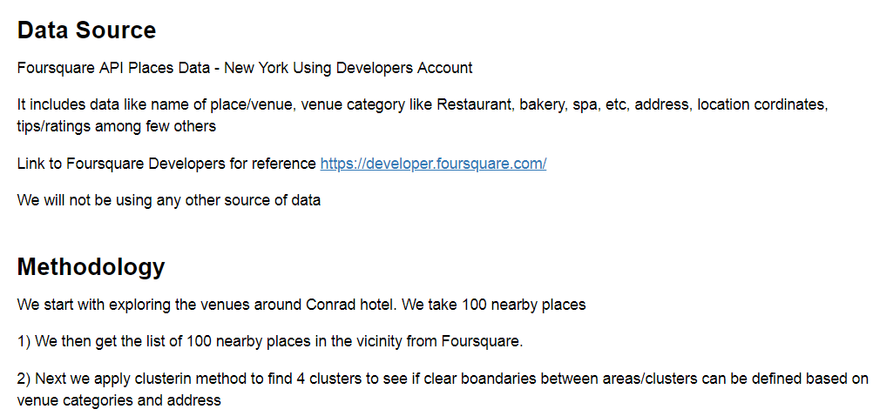

Slide 4
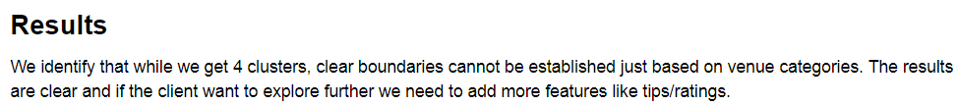
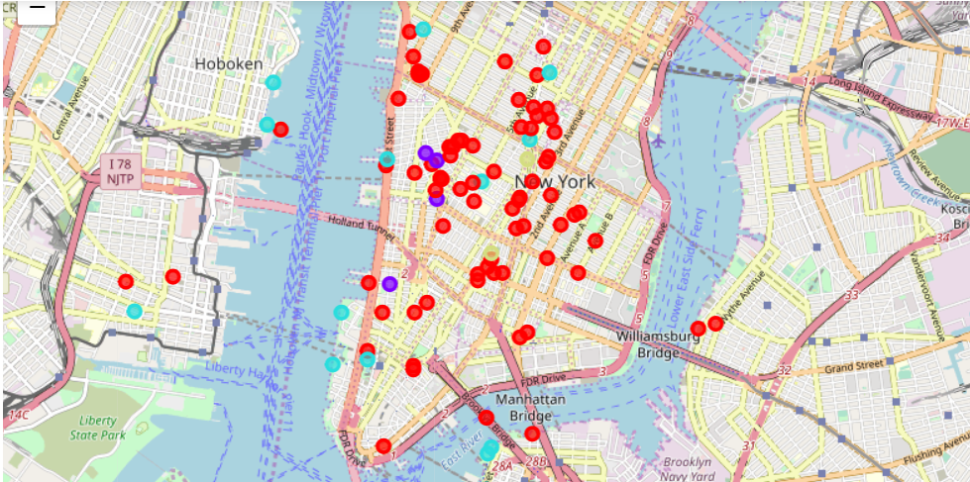

Slide 5
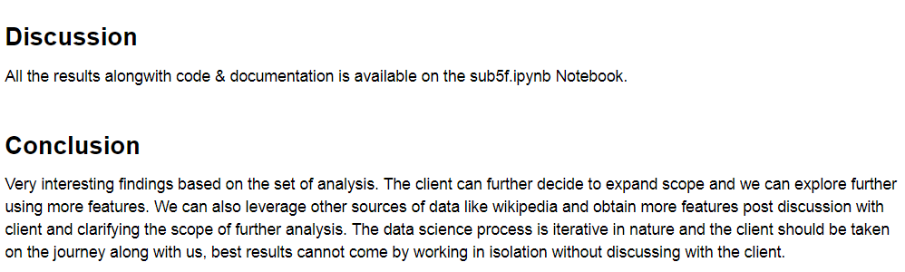
Noetbook and Business Report - Documentations
https://github.com/AviJain11/Capstone/blob/master/sub5f.ipynb
https://github.com/AviJain11/Capstone/blob/master/BusinessReport.ipynb

